Slide 1
CORE JAVA

Slide 2

MAVEN:

Slide 3
Introduction:
Maven is a tool for project management and build automation which is hosted by Apache software foundation.
Maven provides following features:
•Build tool Capabilities
•Run Reports
•Generate a website
•Dependency Management
•Repositories ( Reusable Plug-ins )
•Continuous Integration build systems
•Portable

Slide 4
Maven allows to comprehend the complete state of a development effort in the shortest period of time.
Maven is driven in a declarative fashion using Maven's Project Object Model namely (POM).
POM consists of entire project Information in an XML document.

Slide 5
JUnit:
Junit is a free, open source, software testing framework for java.
Junit tests are java classes that contain one or more unit test methods.
JUnit offers some support so that the developer can easily write test files.
It includes a tool which is called test runner to run your test files.
TYPES OF TESTS:
Black box testing
White box testing
Acceptance testing
Integration testing
System testing
Load testing
Unit testing

Slide 6
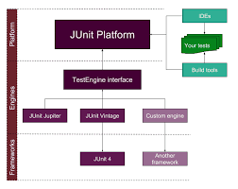
JUNIT Architecture:

Slide 7
Collections:
A Collection is a group of individual objects represented as a single unit.
Java provides Collection Framework which defines several classes and interfaces to represent a group of objects as a single unit.
It has three classes namely List, set and queue.
MAP:
A map is an object that maps keys to value.
A map cannot contain duplicate keys: Each key can map to at most one value.
It has Hashmap,Hashtable,Linked Hashmap,Treemap.

Slide 8
